Slide 1

CTAB STATEMENT TO THE FCC REGARDING ITS RESTORING INTERNET FREEDOM PROPOSAL
Community Technology Advisory Board
July 11, 2017

Slide 2
Overview of NPRM & Title II
The issue here is not net neutrality
The issue is which regulatory scheme will be used to enforce net neutrality principles
The “threshold question” is whether broadband internet access is an information service or a telecommunications service

Slide 3
Background
Communications Act of 1934: Meant to curb monopolistic behavior by AT&T
Telecommunications Act of 1996: Conceived of dial-up internet as an information service

Slide 4
General Draft Comment Strategy
“A comment is not a vote.”

Slide 5
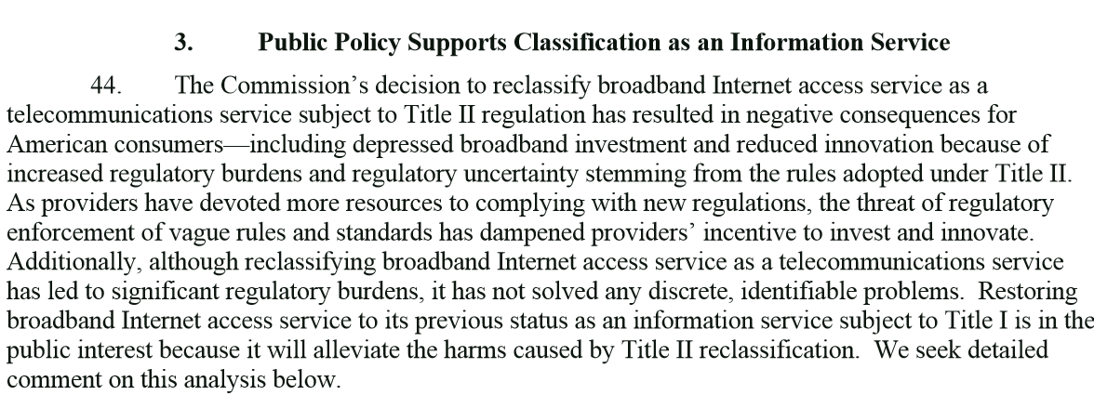
General Draft Comment Strategy: Economics
.

Slide 6
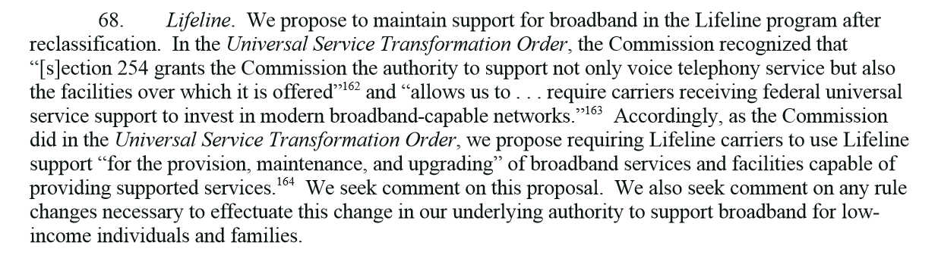
General Draft Comment Strategy: Lifeline
.

Slide 7
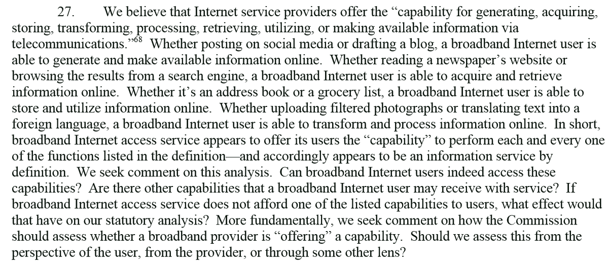
General Draft Comment Strategy: Legal/Technical
“capability for generating, acquiring,
Storing, transforming, processing, retrieving, utilizing, or making available information via
.
telecommunications.”

Slide 8
Next Steps
Lifeline Updates
Personal Stories in Reply or Appendix

Slide 9
Questions & Comments

